Slide 1
PUC Validation date
SAHIL Makhaniya
21162121014
ESFP-II – PROJECT
BDA:22

Slide 2
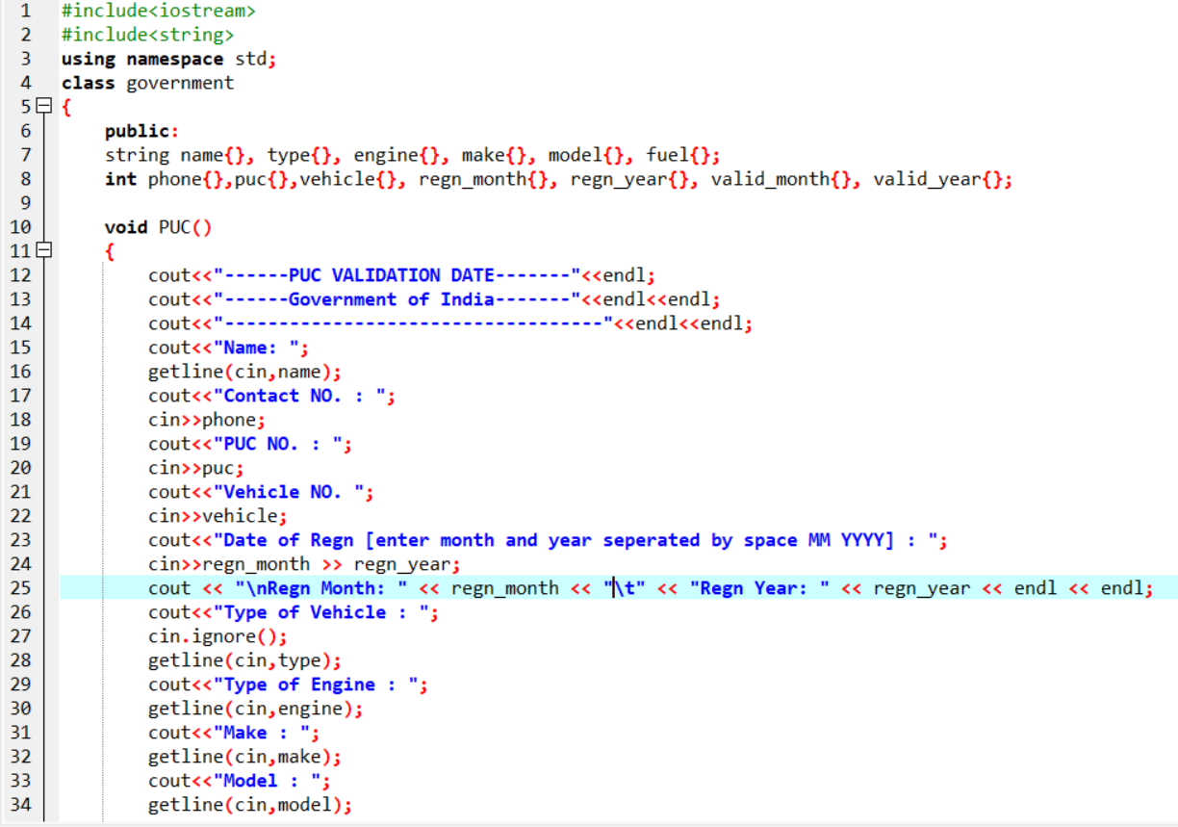
CODE:

Slide 3
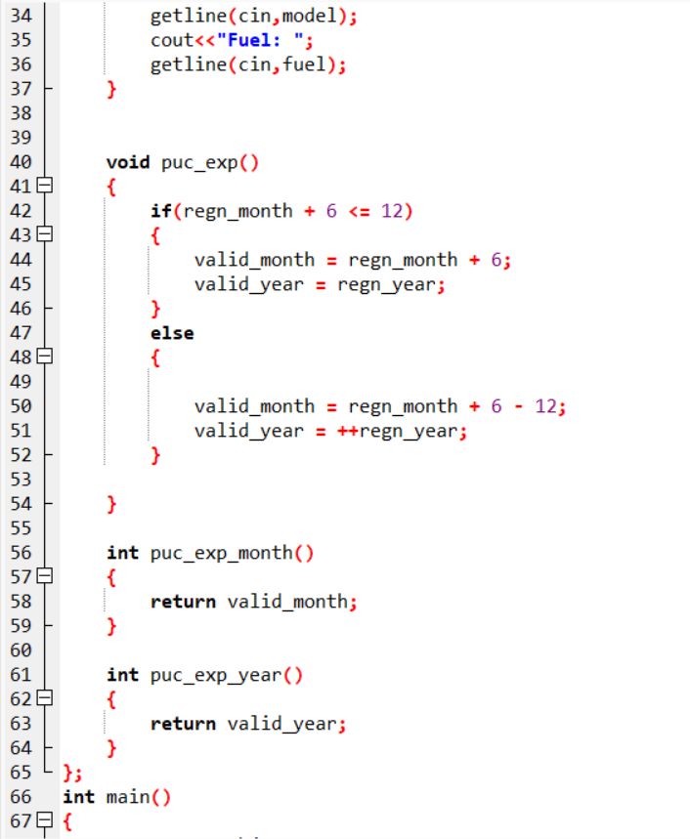
CODE:

Slide 4
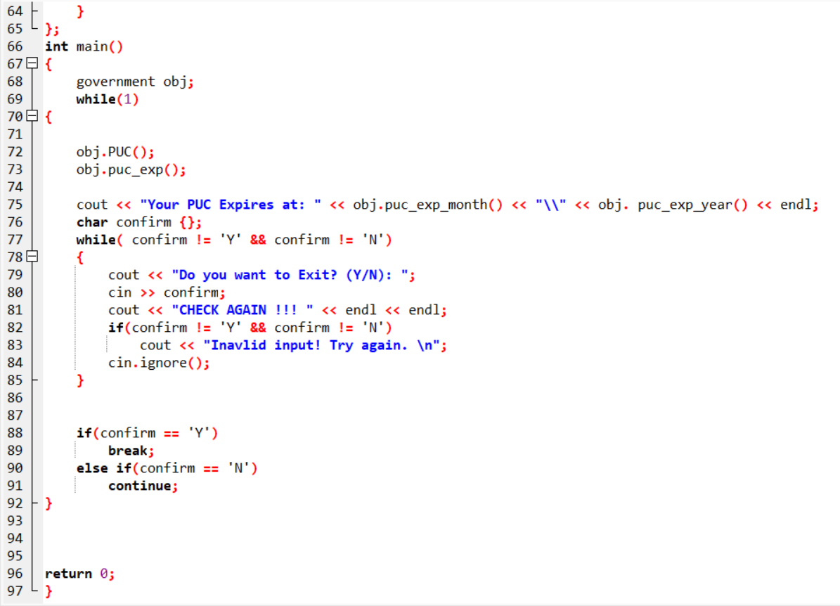
CODE

Slide 5
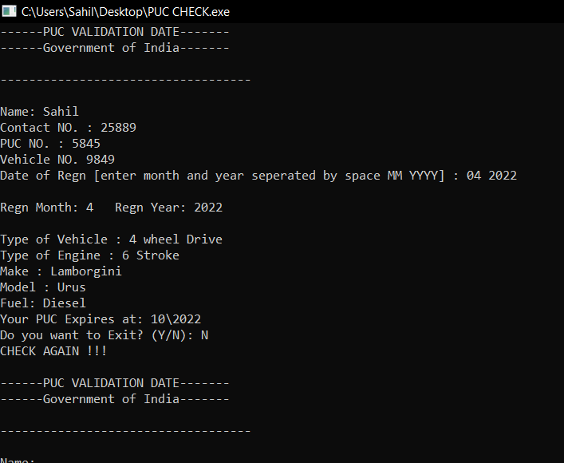
OUTPUT

Slide 6
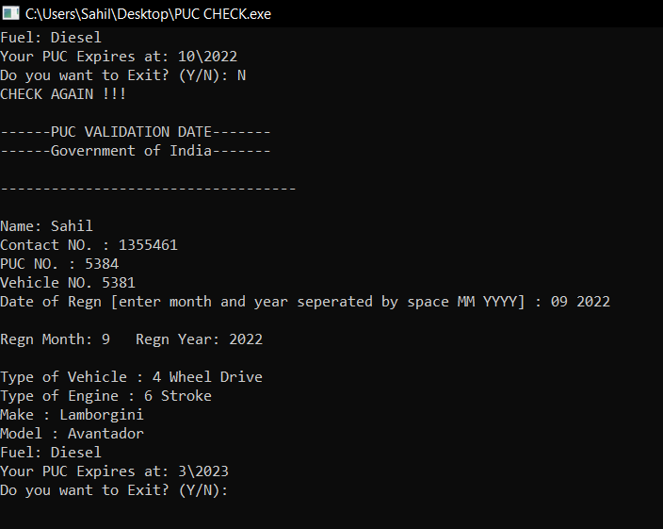
Output

Slide 7
If - else
The "else condition" is usually used when you have to judge one statement on the basis of other. If one condition goes wrong, then there should be another condition that should justify the statement or logic.
int a = 100;
if( a < 20 ) {
printf("a is less than 20\n" );
}
else {...

Slide 8
WHILE LOOP
A while loop evaluates the condition
If the condition evaluates to true, the code inside the while loop is executed.
The condition is evaluated again.
This process continues until the condition is false.
When the condition evaluates to false, the loop terminates
While(oondition)

Slide 9
Class and object
Classes. A class in C++ can be viewed as a blueprint or a skeleton of a particular entity. ...
Objects. In order to use the class functionality, we need to instantiate the class to create an object. ...
Access Specifiers. ...
Constructors. ...
Types of Constructors. ...
Assignment Operator. ...
Destructors. ...

Slide 10
Thank you
~ sahil makhaniya

